Slide 1


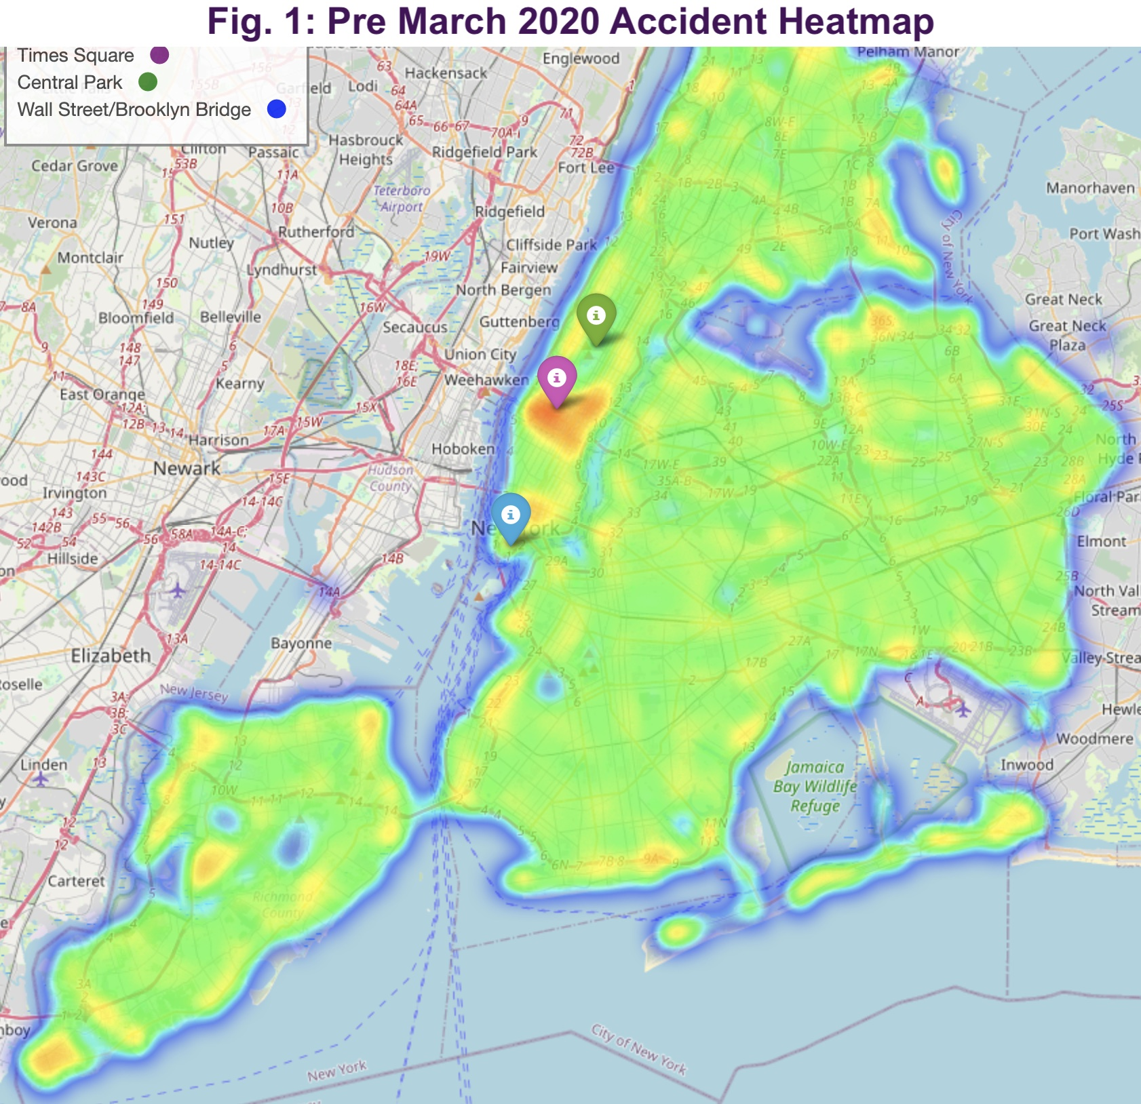
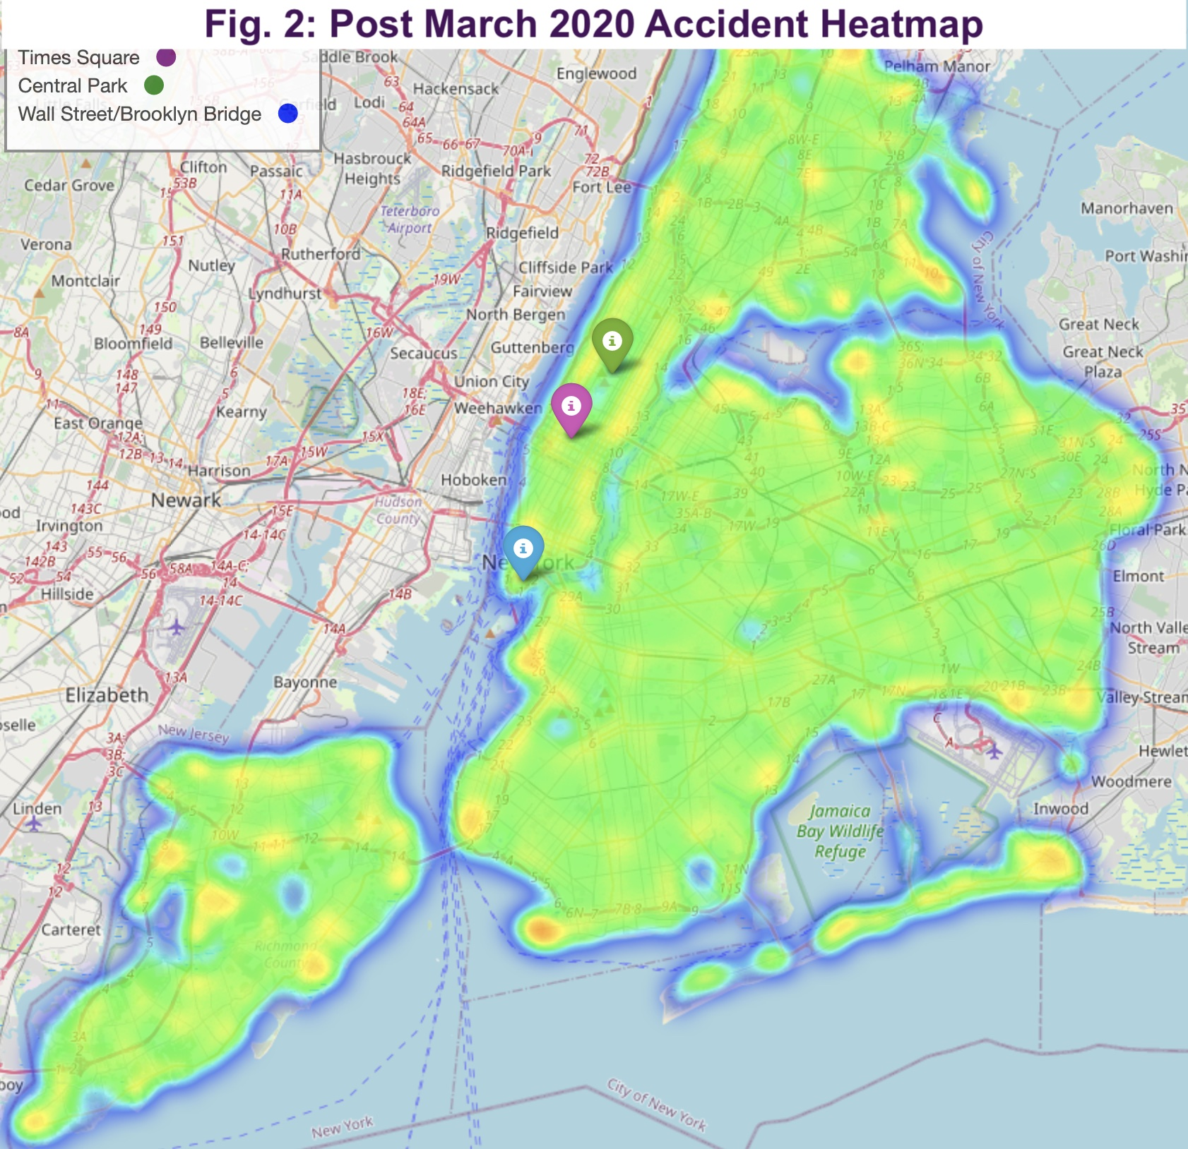
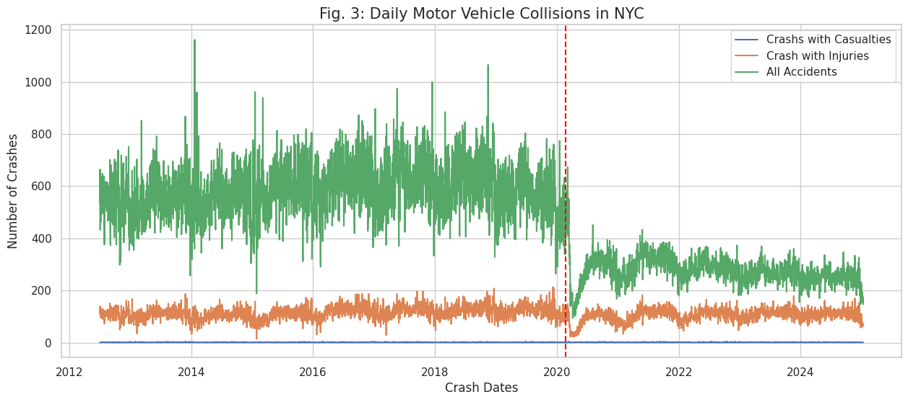
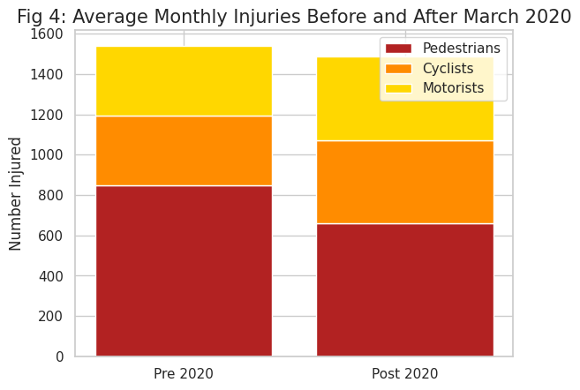
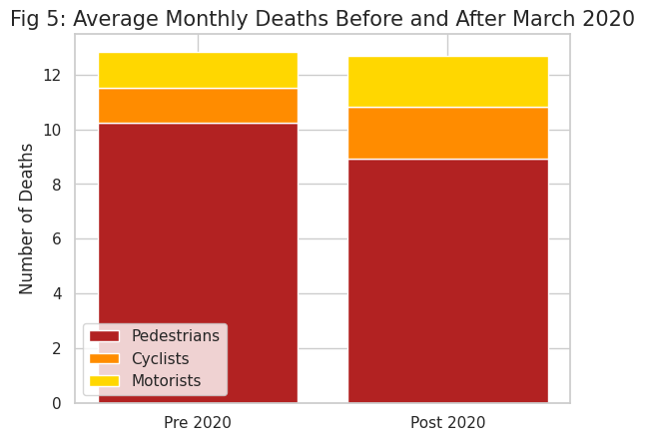

Analysis of Car Accident Trend Changes Due to Covid-19 Liz Ragsdale | Advisor: Dr. Joesph DeMaio
School of Data Science and Analytics | Kennesaw State University
Introduction
Results
Millions of car accidents occur every year in the USA resulting in injuries, deaths and increased traffic congestion. Did the Covid-19 pandemic impact the frequency and/or severity of traffic accidents? Leveraging a dataset documenting vehicle accident details from the past ten years in New York City, this project investigates the changes observed in car crash frequencies and variance before and after March 2020.
We conducted geospatial analysis of the data to identify location-based trends and a time series analysis to determine if those trends were consistent across the entire timeframe. By identifying the patterns or trends in the NYC accident data, perhaps more targeted and effective solutions can be created to widely reduce the number of accidents occurring nationwide due to necessary changes in behavior dictated by Covid-19.
Fig. 1 & 2:
The two heatmaps depict the density of crash occurrences across NYC, figure 1 showing pre-Covid-19 pandemic measures in March 2020, and figure 2 showing post March 2020. Figure 1 shows a hotspot around high traffic tourist areas as well as the Manhattan side of bridges. This hotspot is not present post March 2020.
Fig: 3:
This graph depicts the daily number of accidents, with additional lines of accidents with injuries and with casualties. There is a sharp shift in the number of daily crashes following March 2020 (red line) that is seen in both total crashes and accidents. However, daily crashes remained lower than prior years while injuries and casualties resumed the pattern seen prior.
Fig: 4 & 5:
Two stacked bar charts depicting the breakdown of mean monthly injuries and deaths respectively among motorists, cyclists and pedestrians between the time frames. While the overall mean monthly injuries and deaths did not significantly change, there was a reduction in pedestrian injuries in deaths between the time frames.
Methods
The dataset was provided by the NYC OpenData team and documents accidents where a NYPD accident report was filed. Starting in 2012, the dataset contains over 2 million accidents and information regarding each crash’s time, location and severity.
The data cleaning process removed crashes without location data and sorted the accidents by crash date. Subsets of before March 1, 2020, and after March 1st were also created for use in the analysis. The date for the split was chosen based on when NYC Covid-19 pandemic measures started going into effect
A geospatial analysis was conducted via mapping of accidents to to determine if there were commonalities among hotspots and if there was a change in accident patterns between the two timeframes.
To analyze any shifts in crash severity a time series analysis was conducted on all accidents, accidents with injuries and accidents with casualties to determine if changes in accident trend over time was consistent across severity. Additionally, the change in the monthly average of people involved in accidents was analyzed using Welch’s T-test and visualized with a stacked bar chart.
Welch’s T-test P-values | Pedestrians | Cyclists | Motorists
Injured | P < 0.0001 | P = 0.009 | P = 0.001
Casualties | P = 0.03 | P = 0.02 | P = 0.003
Conclusions
Geospatial analysis (fig 1 & 2) showed a shift in traffic accident patterns following March 2020, with a large reduction in hot spots that correspond with densely trafficked areas like Times Square or bridges. This could be due to a reduction in overall traffic, which aligns with the change in overall crashes seen in fig. 3, or a sign of larger change in traffic patterns resulting from the shift to work from home, due to the persistence of the trend even after restrictions were lifted.
The severity analysis showed that overall crashes saw a change in pattern, to be overall lower and with less variance after March 2020. However, the crashes with injuries and casualties returned to the pre-pandemic pattern a few months after March 2020 indicating that car accidents, on average are more severe than prior to 2020. The distribution of those injured and killed in crashes were found to be significantly different via the Welch’s T-test. Pedestrian injuries and deaths saw a decrease while motorist and cyclist injuries and deaths saw an increase after March 2020. This change indicates a need for further research to understand the causes of that shift.
Python Code & Sources
Scan for Code
Dataset source and information:“
Motor Vehicle Collisions - Crashes: NYC Open Data.” Motor Vehicle Collisions - Crashes | NYC Open Data, 15 Apr. 2025,
“Timeline of the Covid-19 Pandemic in New York City.” Wikipedia, Wikimedia Foundation, 20 Mar. 2025,

